Slide 1

Automation Testing

Slide 2

Agenda
Reasons of using Automating testing
Automation testing - Limitations
Introduction to Appium
Advantages/Dis-advantages
Requirement’s for using Appium/Selenium
Tools used
Demo

Slide 3
Reasons of using Automating testing
Validate requirements and functionalities
Accurately reproduce test
More test in shorter period of time
Build regression test suite.
Reduce the time taken by repetitive and tedious testing task

Slide 4
Noticeable factors
Do not replace manual testing
Cannot eliminate test planning
Need to be in early state of the project
Will not work in the earlier releases
Will not succeed without the knowledge of basic software engineering languages

Slide 5
Introduction
Appium is a NodeJs based Open-source tool for automating mobile applications.
Supports Native, Mobile web and Hybrid Applications on Android, iOS and widow's desktop
Appium automated test cases can run on Physical device or on emulator or simulators.
Its Client-Server Architecture
Communicates with the client through the HTTP JSONWire Protocol using JSON objects.
It creates a session and returns the session id.
Uses UIAutomator for Android, XCUITest for Apple devices and WinAppDriver for windows.

Slide 6
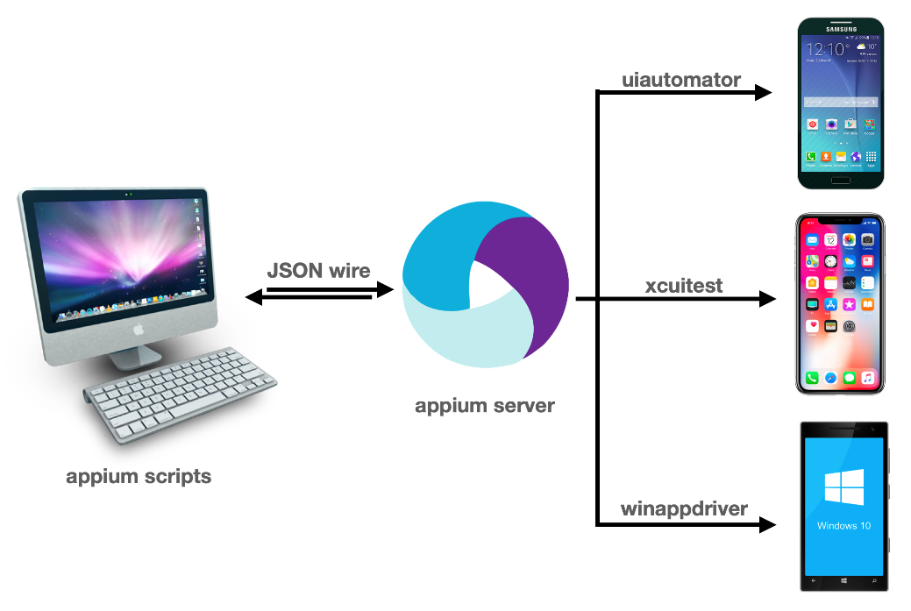
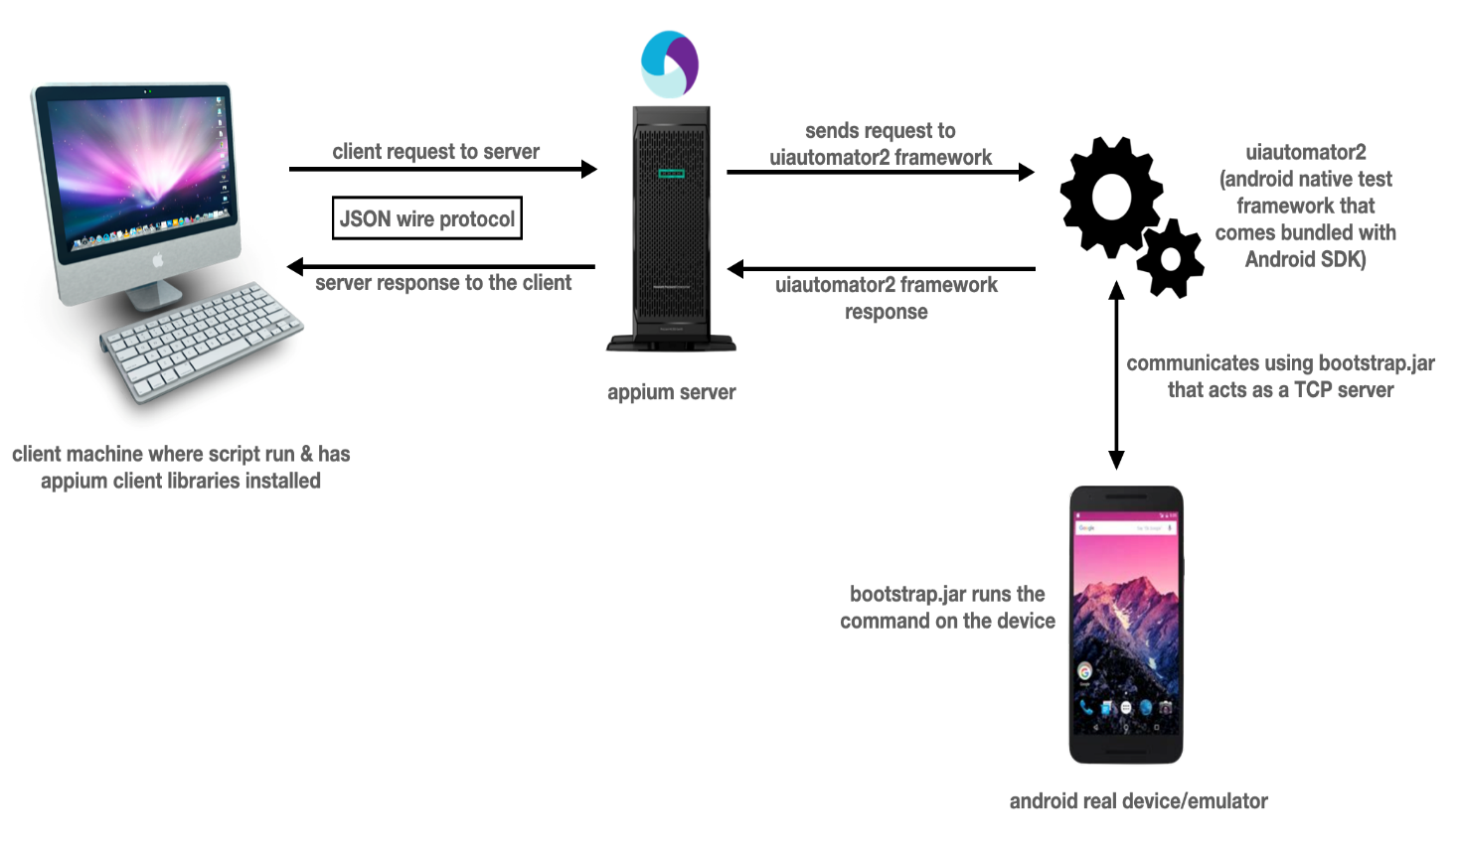
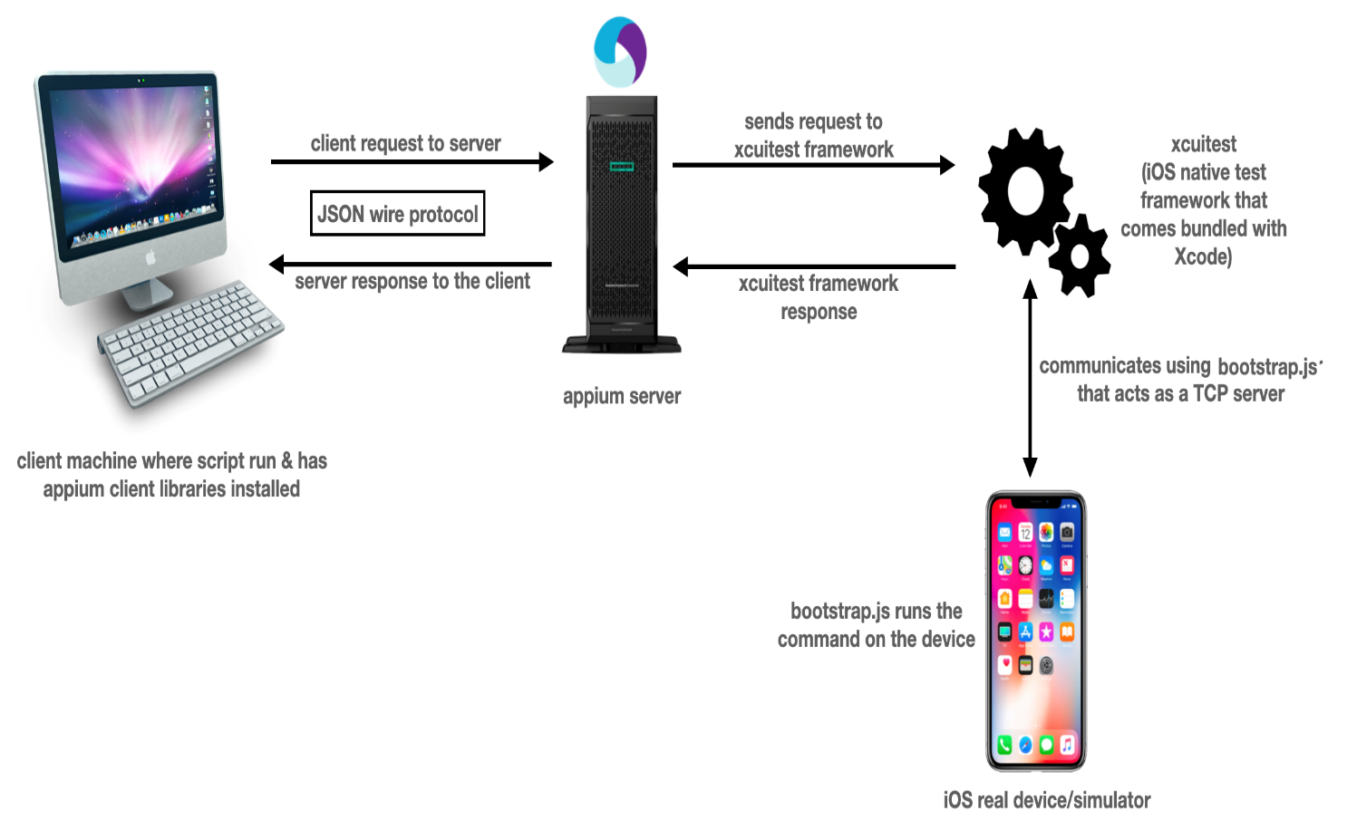
Appium Architecture

Slide 7
Advantages
Appium is free and open-source
Supports both iOS and Android
Test can be written using any language
Automation test for iOS and Android can be written using same API
Disadvantages
Configuration and setup is complex.
Only one iOS device at a time can be run in Appium.
No support for lower version

Slide 8
Requirements / Tools
JAVA IDE (Eclipse), Java JDK
Maven Plugin for Eclipse
Selenium WebDriver Dependencies/Appium Java-Client Dependency (Maven)
Android SDK
Xcode for iOS
Emulator/ Real Device
Appium Server
Node.js (If running Appium from source)

Slide 9
Requirements : (Java)
JAVA IDE (Eclipse), Xcode for iOS
Java JDK
Maven Plugin for Eclipse
Selenium WebDriver Dependencies/Appium Java-Client Dependency (Maven)
Android SDK
TestNG
Emulator/ Real Device
Appium Server
Node.js (If running appium from source)

Slide 10
Project implemented – WWF Test-Cases
1. Verify Landing Screen Contents
2. Social Account Login
3. Login Screen Validation
4. Login
5. validating of sign-in process.
6. validating of sign-up process.
7.Verify Social Media Icon Navigation of sign-up screen.
8. Sign-Up

Slide 11
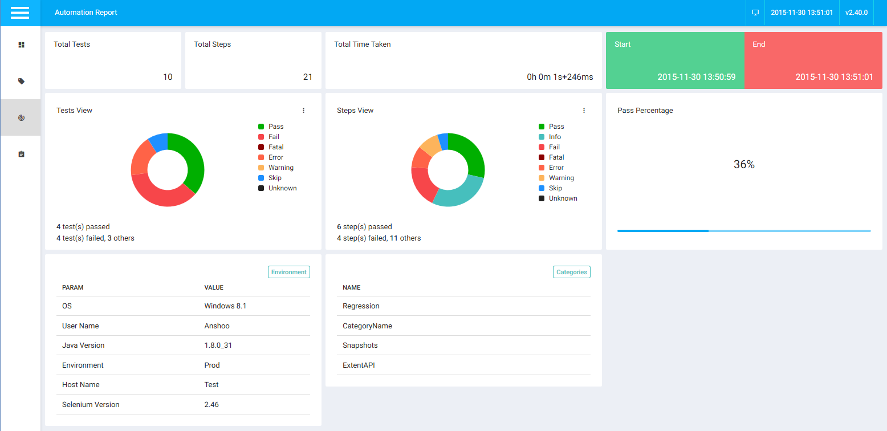
Testing-Report

Slide 12
Conclusion
Automated test cases with Appium allows cross-platform test.
To stop repetitive test cycles, to make application efficient and free bugs automated test with Appium for mobile application would save cost and time.

